Slide 1
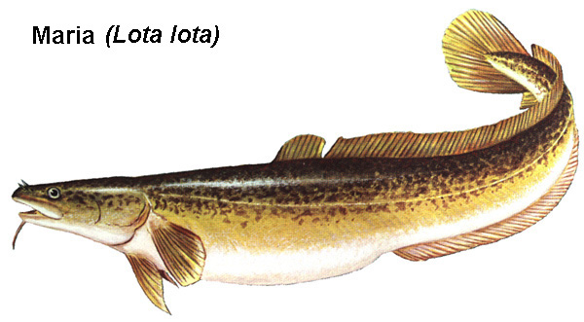
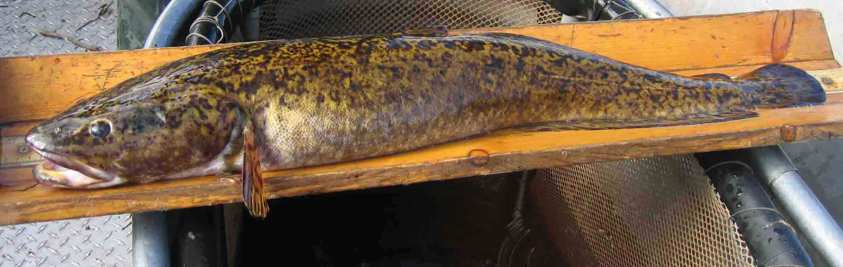
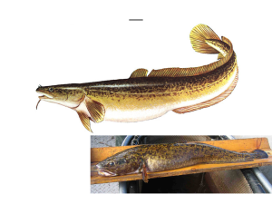
__
Notes:
Burbot or Ling

Slide 2
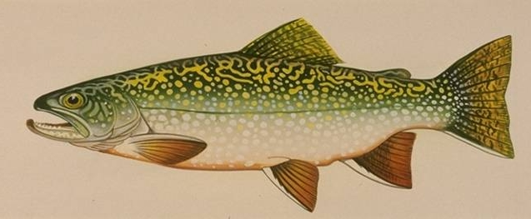
__
Notes:
Splake

Slide 3
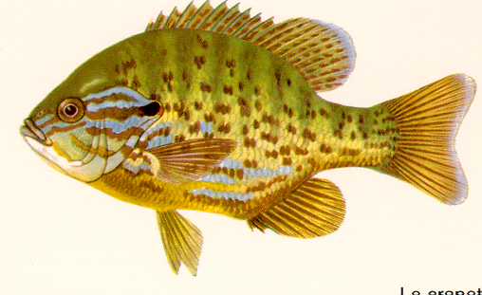
__
Notes:
Pumpkinseed

Slide 4
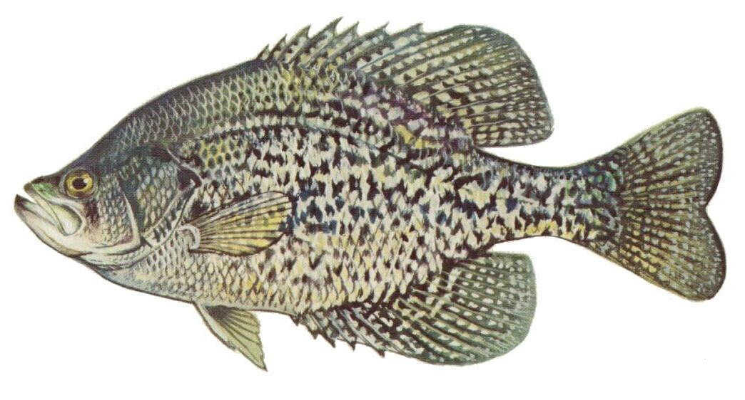
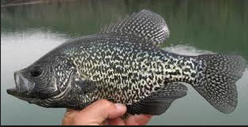
__
Notes:
Black Crappie

Slide 5
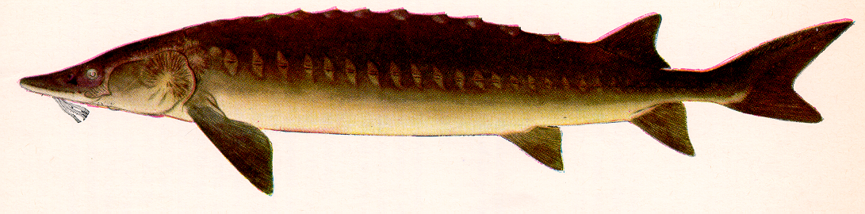
__
Notes:
Lake Sturgeon

Slide 6
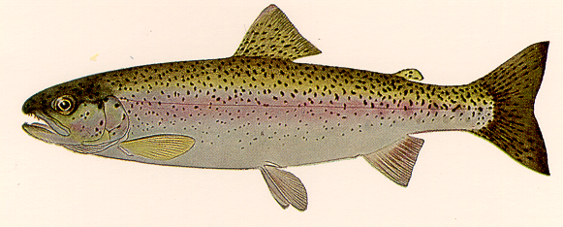
__
Notes:
Rainbow Trout

Slide 7
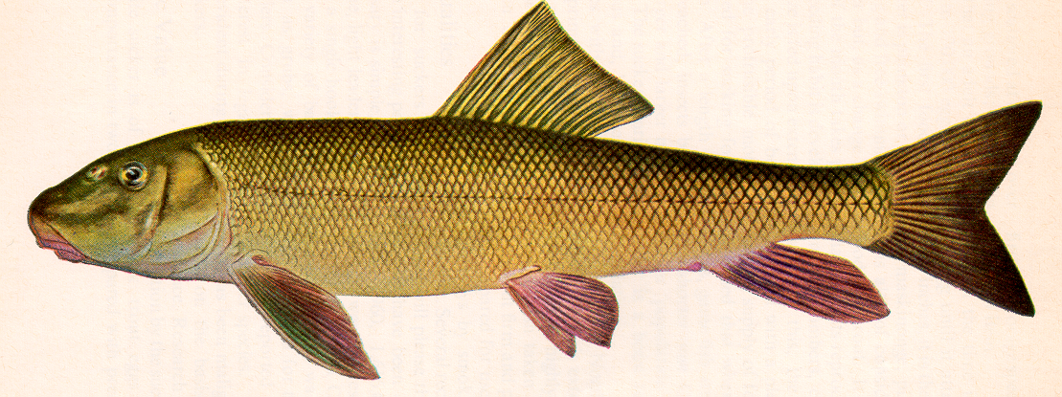
__
Notes:
White Sucker

Slide 8
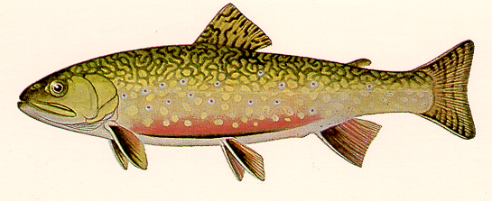
__
Notes:
Brook or Speckled Trout

Slide 9
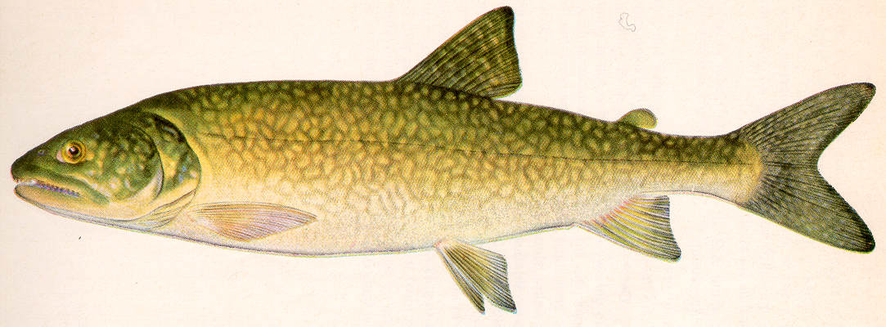
__
Notes:
Lake Trout

Slide 10
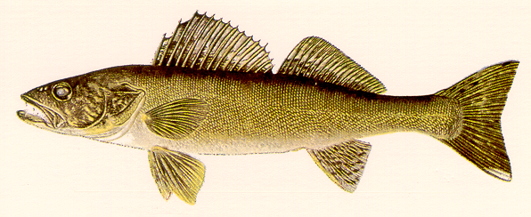
__
Notes:
Walleye

Slide 11
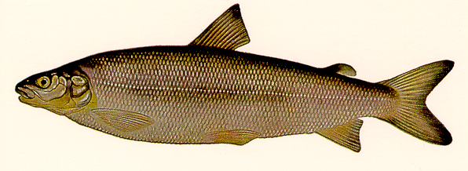
__
Notes:
Lake Whitefish

Slide 12
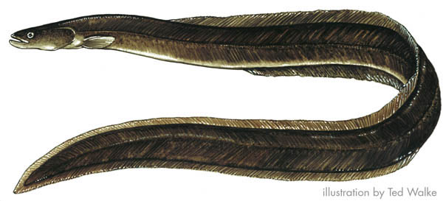
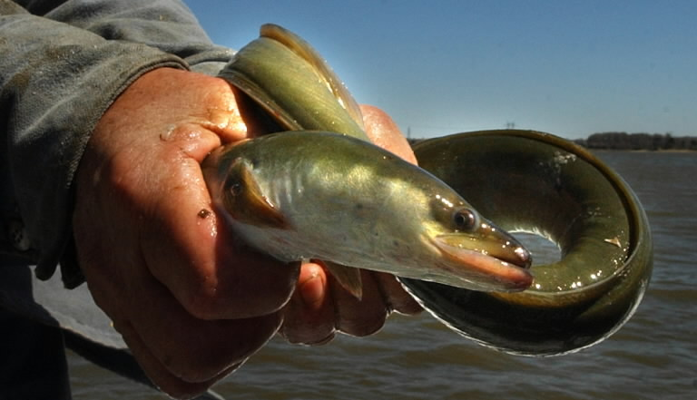
__
Notes:
American Eel

Slide 13
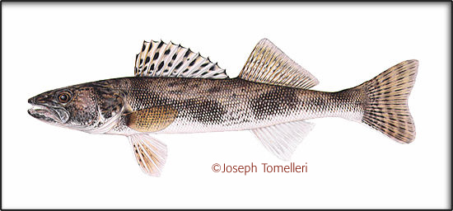
__
Notes:
Sauger

Slide 14
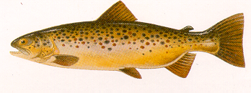
__
Notes:
Brown Trout

Slide 15
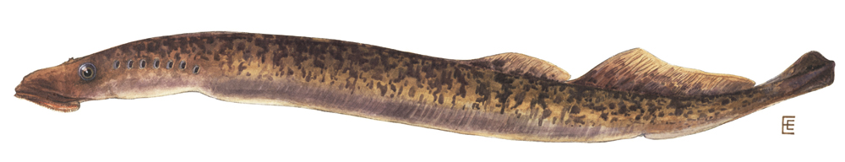
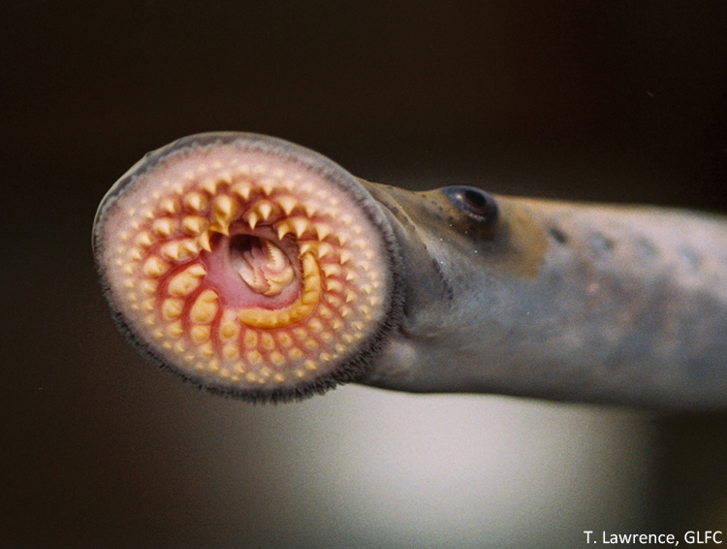
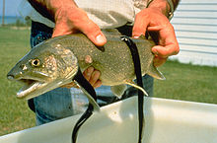
__
Notes:
Sea Lampry

Slide 16
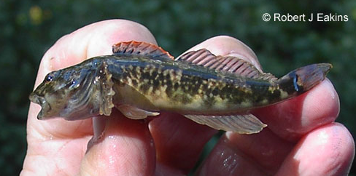
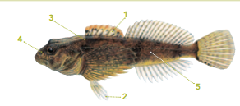
__
Notes:
Sculpin (native)

Slide 17
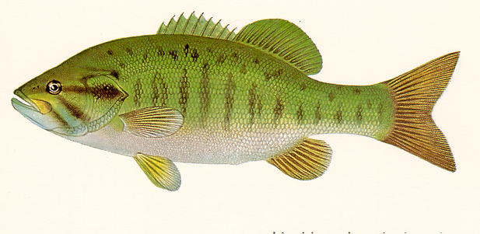
__
Notes:
Smallmouth Bass

Slide 18
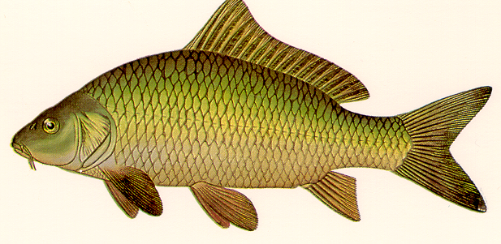
__
Notes:
Common Carp

Slide 19
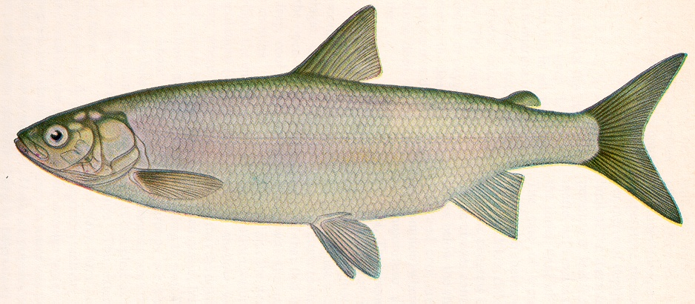
__
Notes:
Lake Herring or Cisco

Slide 20
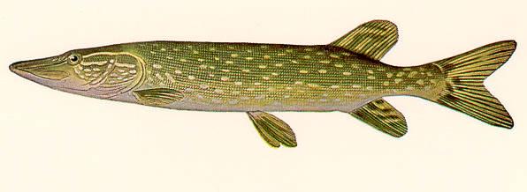
__
Notes:
Northern Pike

Slide 21
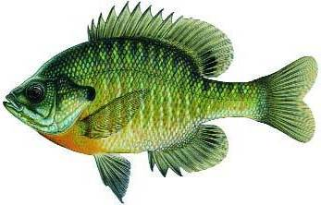
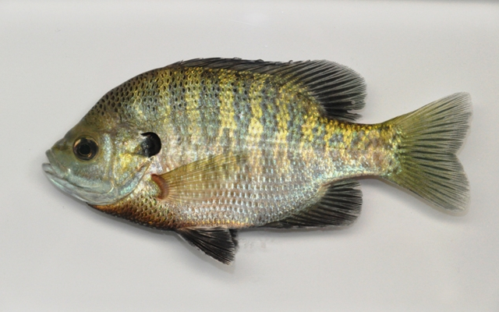
__
Notes:
Blue Gill

Slide 22
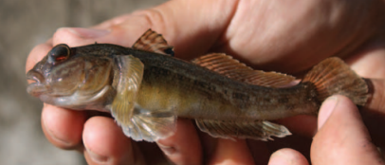
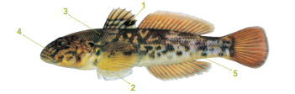
__
Notes:
Round Goby (invasive species)

Slide 23
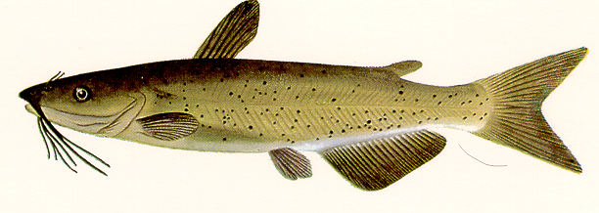
__
Notes:
Channel Catfish

Slide 24
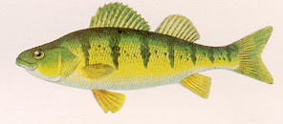
__
Notes:
Yellow Perch

Slide 25
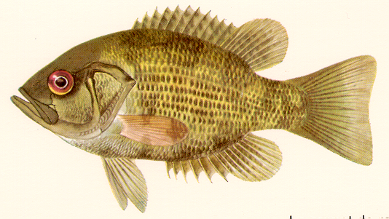
__
Notes:
Rock Bass

Slide 26
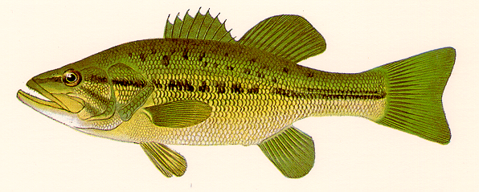
__
Notes:
Largemouth Bass

Slide 27
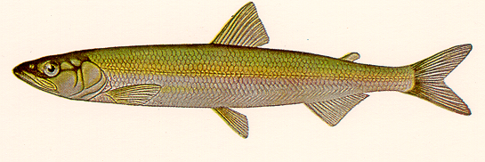
__
Notes:
Rainbow Smelt

Slide 28
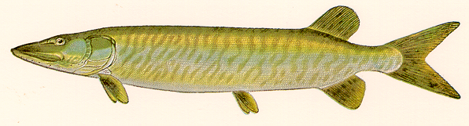
__
Notes:
Muskellunge

Slide 29
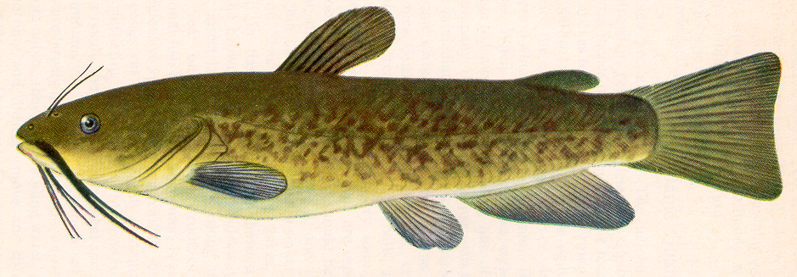
__
Notes:
Brown Bullhead

Slide 30
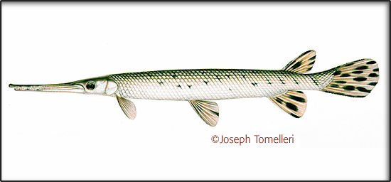
__
Notes:
Longnose Gar

